Slide 1
Fundamentals of Marketing
Aim: What is a market, target market and market segmentation?

Slide 2
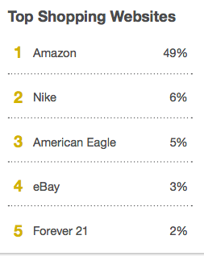
Do Now:
What are the top 5 shopping websites for teens?
How many were correct?
Do you agree?
Why do you think those are the top websites?

Slide 3
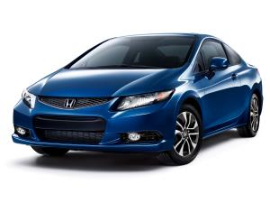
Market
All of the people who share similar needs and wants and who have the ability to purchase a product.
Q. How does someone who is in the market for GTA differ from someone who is buying a new car?

Slide 4
Consumer Market
Consists of consumers who purchase goods and services for personal use.
Usually addresses lifestyles

Slide 5
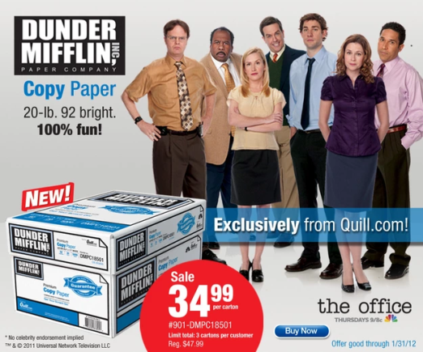
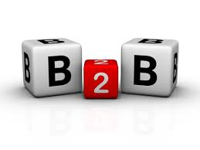
Industrial Market (B2B)
Includes all businesses that buy products for use in their operations.

Slide 6
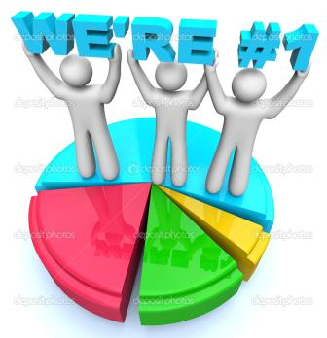
Market Share
A company’s percentage of the total sales volume generated by all companies that compete in a given market.

Slide 7
Activity #1: Try it out
Give 5 examples of goods and/or services in the consumer market

Slide 8
Activity #2
Choose a company (below) in the industrial market and list 5 goods and services they need to purchase to survive.
Taco Bell, Chase Bank, a Bakery, Dell HQ, Fashion Designer
Goods | Services

Slide 9
Activity #3 Lifestyles- Indicate 3 lifestyles and explain the needs and wants for each of the lifestyles.

Slide 10
Target Market
The specific group of customers whose needs a company will focus on satisfying.

Slide 11
Target Market (cont’d)
This is a group of consumers that is identified for a specific marketing program.
Your target market must have the desire and ability to purchase your goods/services

Slide 12
Brainteaser: How much do millennials spend annually on coffee?
Answer: $2,008
What is the desire? _____________________
What is the ability? _____________________

Slide 13
Work Together
Chose a target market:
College Students
Yuppies (Young Urban Professionals)
Teenagers
People older than 65
People who live in a very hot climate.
1 Q. How you would discover your target market’s needs and wants?
2 Q. Brainstorm a list of 5 needs and wants for your target market.
3 Q. Create a list of 10 products that would meet those needs and wants.

Slide 14
DO NOW
For each of the following groups write down a few defining characteristics of their clothing needs/wants.
Teenagers
Business people
Teachers
Babies
People older than 65
Why do different groups of people make different types of purchases?
Why is it important for businesses to recognize different customer needs?

Slide 15
Marketing is Customer Focused
Customer: an individual or group who buys products. A customer can be a(n):
Individual
Business
Non-profit organization
Government.
How have your wants and needs changed since you were a child?

Slide 16
Customer Profile
Develops a clear picture of a target market. Lists information such as:
Age
Income level
Ethnic background,
Occupation
Attitudes
Lifestyle
Geographic location

Slide 17
Think about it
What’s the difference between a customer and a consumer?
When can they be different?

Slide 18
Customer vs. Consumer
Consumer – uses product
Customer- buys product
Q. When are they the same, and when are they different?

Slide 19
Think about it
Consider the toothpaste market. How do toothpaste companies target different needs?

Slide 20
Mass Market
When all customers for a type of product are considered together
What are the mass markets for:

Slide 21
Market Segmentation
A subgroup of a larger market with similar wants and needs for a particular product.
A large market can have many market segments
Ex: Soda or cars
Q. Why are markets segmented?

Slide 22
Work Together
Work in groups of two.
You will be assigned one of the following mass markets:
car buyers
home buyers
bicycle buyers
bread buyers
computer buyers
cell phone buyers.
Identify as many segments as possible in five minutes.
PRESENT

Slide 23
Closure
Q. Were you able to easily and accurately create a customer profile based on the contents of the magazine?
WHY/ WHY NOT?

Slide 24
The Marketing Mix
Do Now: What is your five year plan? If you don’t have a five year plan, think of what you would like to achieve in the next five years and include how you will accomplish these goals.
You should include financial, personal and professional goals.

Slide 25
The Marketing MIX
How can a marketer meet customer needs and make a profit? There are probably hundreds of ways to accomplish this…
Marketers meet this goal by developing a plan of action.
Each plan of action consists of four elements called the Four Ps
Product
Place
Price
Promotion

Slide 26
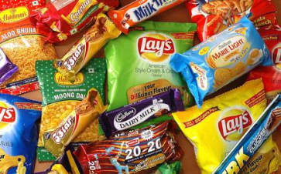
4 Ps- PRODUCT
Product Decisions – involve the goods, services, or ideas used to satisfy consumer needs
What does the customer want from the product/service? What needs does it satisfy?
What features does it have to meet these needs?

Slide 27
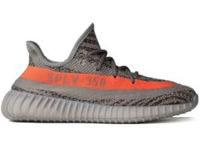
4 Ps- PRICE
Cost?
Price Decisions – Price also influences customers buying decisions
What is the value of the product or service to the buyer?
Are there established price points for products or services in this area?
Is the customer price sensitive?
How will your price compare with your competitors?

Slide 28
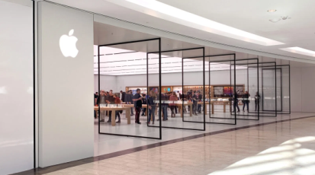
4 Ps- PLACE
Place decisions – involves making the product available to the customer, Marketers must determine how and where their target market shops.
If they look in a store, what kind? A specialist boutique or in a supermarket, or both? Or online? Or direct, via a catalogue?
How can you access the right distribution channels?

Slide 29
4 Ps- PROMOTION
Promotion Decisions – Involves how the goods or services are communicated to the consumer.
Where and when can you get across your marketing messages to your target market?

Slide 30
Today’s Activity
Analyze the magazine you have been given.
Each person in your group will assume one of the following roles:
Article inspector
Cover examiner
Advertisement guru
Create the customer profile and complete the handout.
Be prepared to share your profiles with the class!

