Slide 1
Consumer Behavior and Demographics

Slide 2
Do now: What are the characteristics of people who drink Redbull?

Slide 3
Do now:
Q. Why would marketers want to know these statistics?
Q. What can they do with this information?
Q. What is the marketing term for these stats?

Slide 4
Demographics
Statistics that describe a population in terms of personal characteristics such as
Age
Gender
Ethnicity
Income
Family size
Education
occupation

Slide 5
Geographics
Segmenting a market based on where customers live.
Location
Climate
city size
City type
Region

Slide 6
Psychographics
Segmenting a market based upon psychological characteristics
Hobbies
social activities
Lifestyle
Interests
attitudes

Slide 7
Income
Disposable- the income a person has available to spend (dispose of) after taxes have been taken out
Discretionary- the income left after taxes and necessities of life have been paid for.

Slide 8
Guided Application
With a partner, describe what the typical 4 person household in Bellmore/Merrick is like.
Be sure to touch upon each category of demographics, psychographics, and geographics.
Explain what the avg household will spend their disposable and discretionary income on

Slide 9
Typical Bellmore Merrick HH
Demo | Geo | Psycho | Income

Slide 10
Do now:
Think about your most recent purchase. Why did you make that purchase?
Is this a frequent purchase?

Slide 11
Do Now:
Q. Who has a punch card to Swirlz World, Crave, Dog Groomer.
Why do you have one?
What kind of features are necessary (for you) when you buy a car?
What does this say about who you are?

Slide 12
Behavioral Segmentation
Segmenting a market based on the way customers use a product or behave towards a product.
Behavioral variables include:
features desired
usage rate
brand loyalty

Slide 13
80/20 Rule
80/20 Rule- 80% of sales come from 20% of the customers.
Marketers often segment the market based on how often the customer uses or buys
Product usage rate- heavy, moderate, light, nonuser.

Slide 14
Brand Loyalty
The value of a brand is related to the 80/20 rule. Because of this- marketers often segment the market based on degree of loyalty.
Ex: airlines, department stores, punch cards, etc.

Slide 15
What is your buying behavior?
SRIC- BI Consulting Business Intelligence exam- VALS Survey
Google: Strategic Business Insights
-VALS Survey
http://www.strategicbusinessinsights.com/vals/presurvey.shtml
-Click “Take the survey

Slide 16
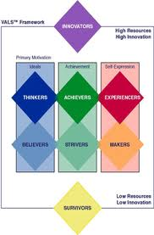
Closure
Q. What was your result?
Q. Do you agree?
Q. What does your result tell you about yourself as a consumer?

Slide 17
Do now:
What are examples of social influences?

Slide 18
Consumer influences:
There are three categories of influences on consumers:
psychological
social
situational

Slide 19
Psychological Influences
The influences that come from within a person.
Our needs are responsible for many of our purchases.
A need is a lack within a person that must be filled.

Slide 20
Q. What is a motive?
Buying motive – a reason a consumer seeks a product

Slide 21
Social Influences
Influences that come from the society in which you live.
Q. What about our society influences us?
culture
family
friends/coworkers

Slide 22
Social Influences (cont’d)
word of mouth publicity- informal conversations about experiences
reference group – neighborhood- class of people one wants to be a part of
Peer pressure

Slide 23
Situational influences
Influences that come from the environment.
weather, physical locations, time of day, visibility, and promotions.
The buyers mood, physical condition, financial condition, time of potential purchase are influences.

Slide 24
Types of Purchases
Impulse purchase- a purchase made without any planning or research.
Where are impulse products displayed in stores?
Routine- a purchase made quickly and without much thought

Slide 25
Types of Purchases (cont’d)
Limited- a purchase decision made with some research and planning
Extensive- involves a great deal of research and planning.

Slide 26
Guided Application
Choose one type of cereal and identify the psychological, social and situational influences associated with buying that type of cereal.

Slide 27
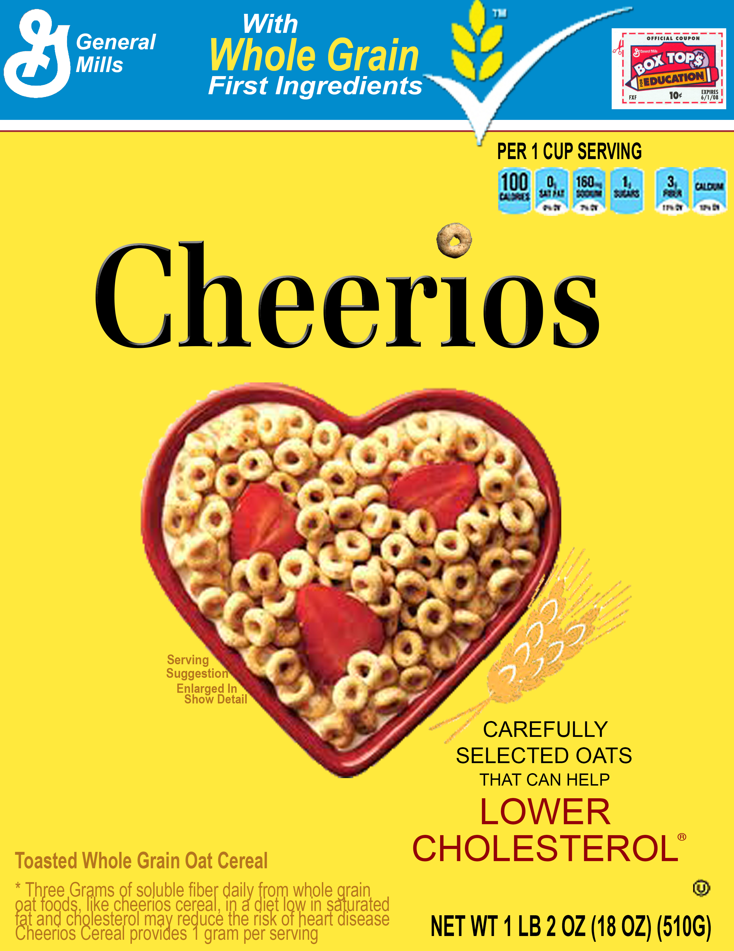
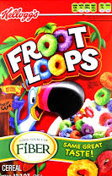

Slide 28
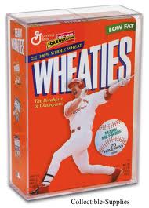
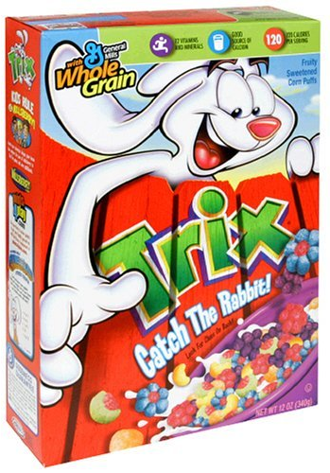

Slide 29
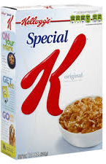
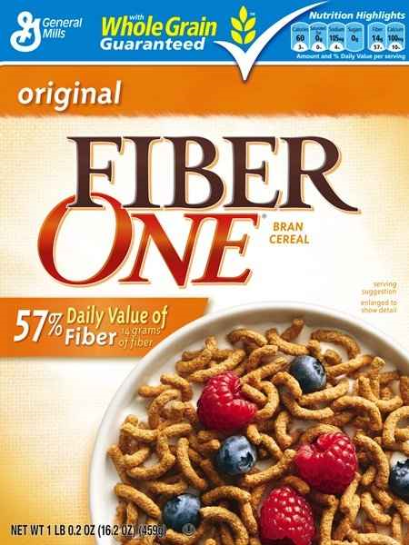

Slide 30
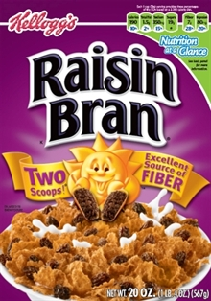
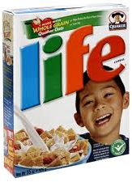

Slide 31
Consumer Behavior Cont’d
Aim: How does Maslow’s Hierarchy of Needs motivates people to act/purchase and consume?

Slide 32
Do now:
Journal:
Think about some of the things you do that you have difficulty with.
In your notes, write down three.
For each one, describe what motivates you

Slide 33
What causes us to act?
Motive- an internal push that causes a person to act
Motivate- to provide the internal push that results in an action.

Slide 34
Wants – Think about it
Want- a conscious desire for something
Q. Are these are learned or innate?
Q. Do you think people are always aware when their basic needs are being met?
Notes:
Sleep/ Oxygen

Slide 35
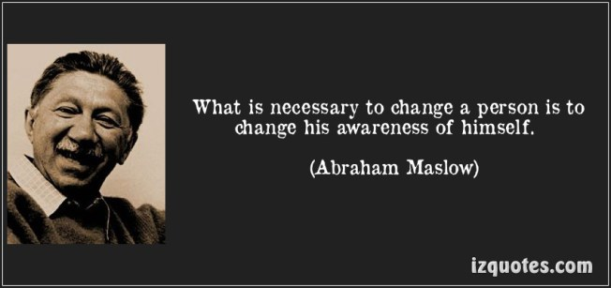
Abraham Maslow

Slide 36
Maslow (1908-1970)
Background info
Was the oldest of seven children of uneducated Russian Jewish immigrants
Abraham struggled in school
Despite this, he loved to read and was able to get into the University of Wisconsin to study Psychology
Later he became a professor at Brooklyn College

Slide 37
Abraham Maslow
Maslow was a leader of humanistic psychology.
Humanistic psychology emphasizes growth and fulfillment.
Maslow wanted to know how people become mentally healthy rather than mentally ill.
His research led him to develop the concept of a hierarchy of needs.

Slide 38
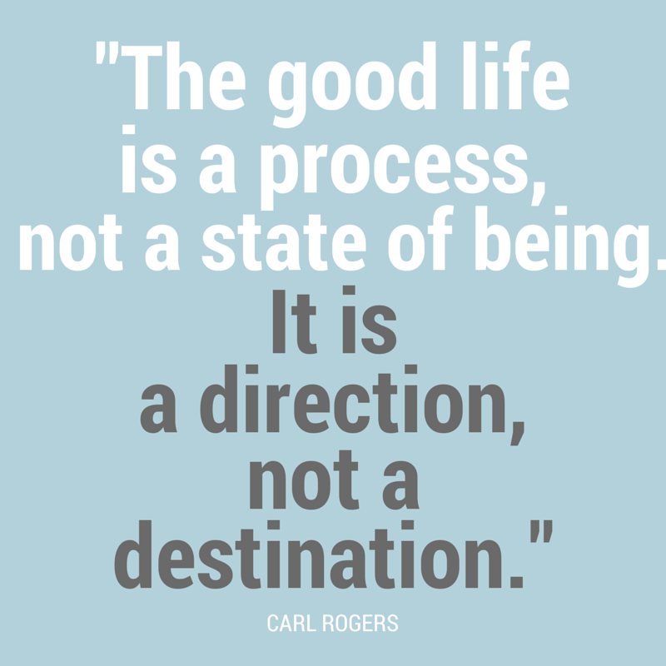

Slide 39
Maslow’s Hierarchy of Needs
Explains WHY people behave the way they do.
He states that unsatisfied needs motivate people to act.
Not all needs are equal- certain needs must be met before others.
The needs at the base must be fulfilled before the needs above it.

Slide 40
Try it first!
Maslow has a hierarchy of 5 human needs.
Work in base groups to put the needs in order- (starting from base to the top).
Choose from the box below
Social
Safety
Self- Actualization
Physiological
Esteem

Slide 41
TRY IT FIRST!

Slide 42
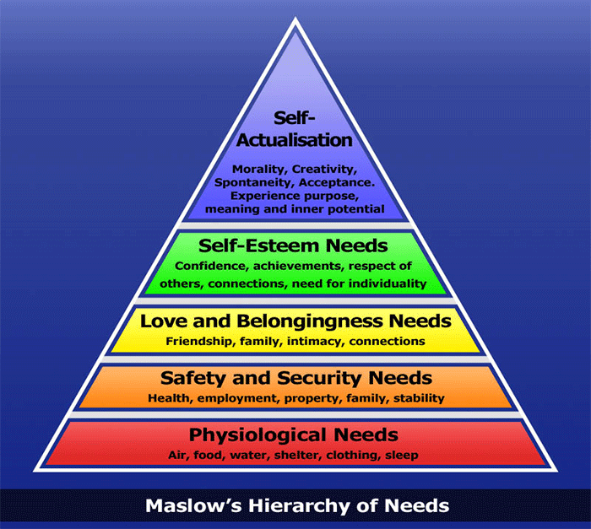
Maslow’s Hierarchy of Needs
Social Needs

Slide 43
Activity: Base Groups
For each product/service you will have to determine which needs on Maslow’s hierarchy it fits in and why.
Q-1 : Is it an impulse, routine, extended or limited purchase?
Q-2 : What type of influence there is on the purchase decision?
Situational
Social
Psychological

Slide 44
Closure- Where do your products belong?

Slide 45
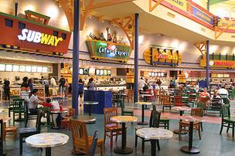
Closure:
According to Maslow’s Hierarchy of needs Why are there food courts in malls?
In what ways do food courts use their captive audience to advertise? What is their end goal?

Slide 46
Closure – Think about it
Think of a major purchase either you or a member of your family made in the last year.
What was it?
What motivated them to purchase it?
Where does it fit on Maslow’s Hierarchy?

Slide 47
Aim: How do we decide to buy?
Q. How does a consumer actually make a decision to buy a product? Marketers think there is a six step decision making process

Slide 48
CB Video
http://study.com/academy/lesson/understanding-the-consumer-decision-making-process-a-marketing-must.html

Slide 49
6- Step Purchasing Decision Making Process
Awareness of need or problem
Information search
Evaluation of options
Decision to buy
Purchase
Post-purchase evaluation

Slide 50
Base groups !
Read the scenario that your group has been given.
Appropriately complete the first step in the decision making process worksheet and pass it to the next group.
Complete the next available step according to what has been filled out.

Slide 51
Base Groups!
Completed worksheets will be returned to the original groups.
Each group will review what the class has chosen for their original scenario.
We will discuss and share outcomes.

Slide 52
DO NOW:
Start to create a study guide for your quiz. You will have 10 minutes.
Topics covered range from:
Demographics to 6 Step Purchasing Decision Making Process

Slide 53
Review
QUIZ TOMORROW!
On Consumer Behavior and demographics
Complete the review worksheet with your partner
Review together 10 mins before period ends

