Slide 1
Promotions
AIM: WHAT IS THE ROLE OF PROMOTIONS IN THE 4p’S?

Slide 2
Do now
Work in pairs to discuss the most outrageous and over the top three promotions you have ever witnessed.
→ Was it successful? Why or why not?

Slide 3
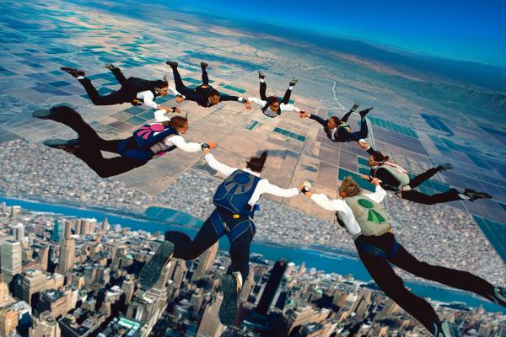
12 most Outrageous PR stunts in History
http://www.prdaily.com/Main/Articles/12_outrageous_PR_stuntsand_the_lessons_learned_9827.aspx

Slide 4
DO NOW
Take out the worksheet from yesterday.
What were your top campaigns?

Slide 5
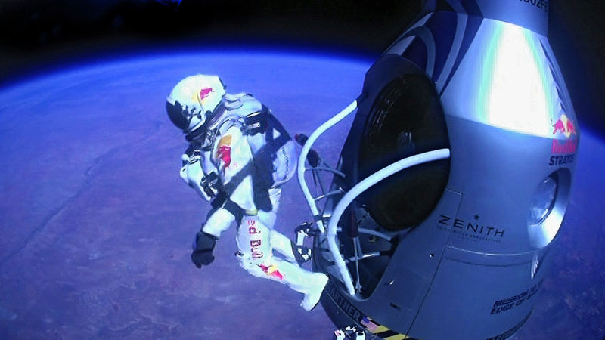
Outrageous campaigns. Do they work?
https://www.youtube.com/watch?v=FHtvDA0W34I

Slide 6
Promotion
Persuasive communication used to inform, remind and entice people to purchase products and services.
Q: What are some reasons a company would use promotional activities?

Slide 7
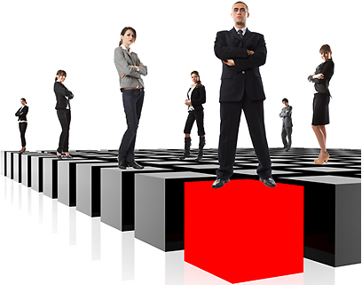
PUBLIC IMAGE
What is meant by public image?
Companies also use promotional activities to enhance their public image and reputation and persuade people that their products are valuable.

Slide 8
AIDA
The goals of promotional activities are summarized by the phrase – AIDA
AIDA:
Attract Attention
Build Interest
Create Desire
Call for Action

Slide 9
What does a good promotion explain?
It would explain:
the major features and benefits
identify where it is sold
advertise sales
answer customer questions
and introduce new offerings
Also, product promotion is used to convince prospects to select a product over a competitor’s.

Slide 10
PROMOTIONAL MIX
There are five basic categories:
Personal Selling
Advertising
Direct Marketing
Sales Promotion
Public Relations

Slide 11
Personal Selling
Requires that company employ a sales representatives who generate and maintain contact with prospects and customers. Costliest form of promotion.
Q: How does direct marketing generate responses?
Special offers, coupons, discounts.

Slide 12
Advertising
Is a form of non-personal promotion. Companies pay to promote ideas, goods, or services in a variety of media outlets.
One-way communication!
Q. Where do companies advertise?

Slide 13
Direct Marketing
Is a type of advertising directed to a targeted group of prospects and customers rather than to a mass audience.
The two forms are printed and electronic direct mail.
One-way communication!

Slide 14
Sales Promotion
Consists of all marketing activities other than personal selling, advertising, direct marketing, and public relations that are used to stimulate purchases/sales, and a positive corporate image.
Ex:

Slide 15
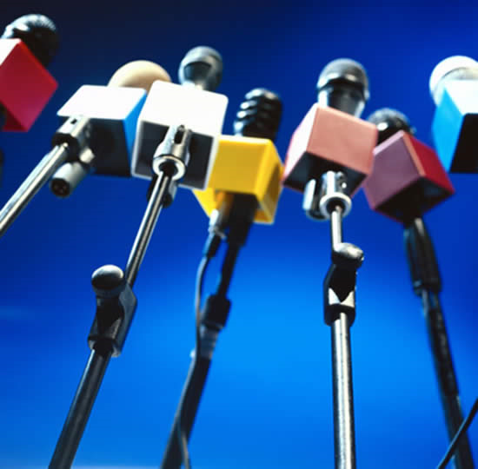
Public relations
PR activities enable an organization to influence a target audience and cultivate media relations.
(PR) campaigns try to create a favorable image for the company, its product or its policies.

Slide 16
Why do companies use the promotional mix?
The concept of the promotional mix is to use a combination of the mentioned strategies while implementing a cost effective allocation of resources.

Slide 17
LET’S REVIEW!
What is promotion?
What are the different types of promotions?
What is meant by one-way communication?
Why is public relations an important component of the promotional mix?

