Slide 1
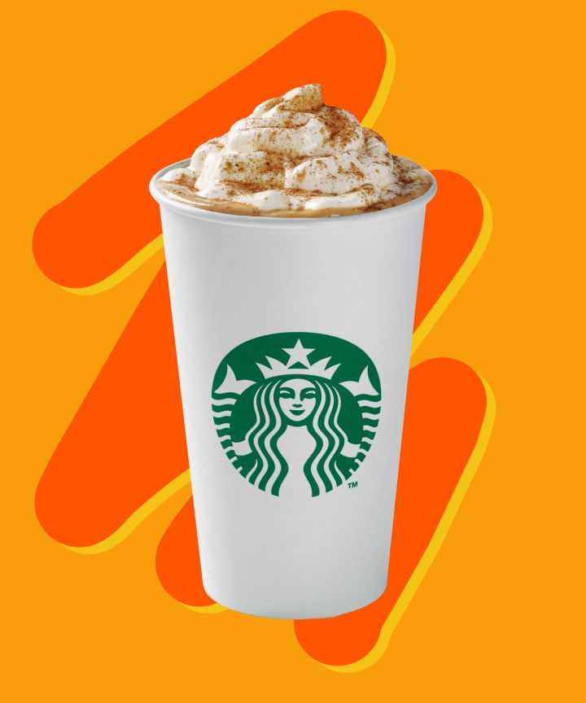
Do now:
Unit 1: The Importance of Marketing
Aim: What makes goods/services useful to consumers?
What makes the PSL so popular?

Slide 2
Activity #1/ Discussion:
What is it about the following scenarios that make for unsuccessful products/services?

Slide 3
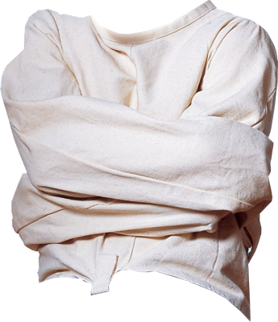
What’s a jacket without a zipper?

Slide 4
If a McDonalds exists in the middle of a forest and no one is around to visit, does it still make burgers?

Slide 5
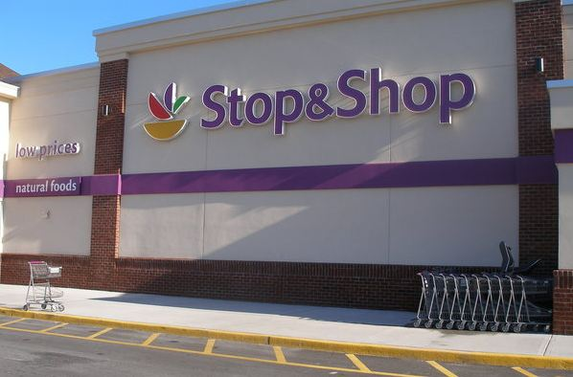
Hours: 12am-5am

Slide 6
New and Improved Products
Marketing generates competition which fosters new and improved products.
By always looking to satisfy the customer, businesses create a variety of goods and services

Slide 7
Lower Prices
Marketing activities increase demand which helps lower prices.
Manufactures can produce products in larger quantities which reduces fixed cost per unit.
Company can charge less and sell more.
When products become more popular more competitors enter the marketplace.

Slide 8
Added Value and Utility
The functions of marketing add value to a product

Slide 9
Utilities
The attributes of a product/service that make it capable of satisfying customer wants and needs.

Slide 10
5 Utilities
There are 5 utilities involved with all products:
Form Utility
Place Utility
Time Utility
Possession Utility
Information Utility

Slide 11
1- Form Utility
Involves changing raw materials, or putting parts together to make them more useful
Ex: a zipper, buttons, thread compared to the value of a jacket
Ex: Electronic controls on a steering wheel add form utility

Slide 12
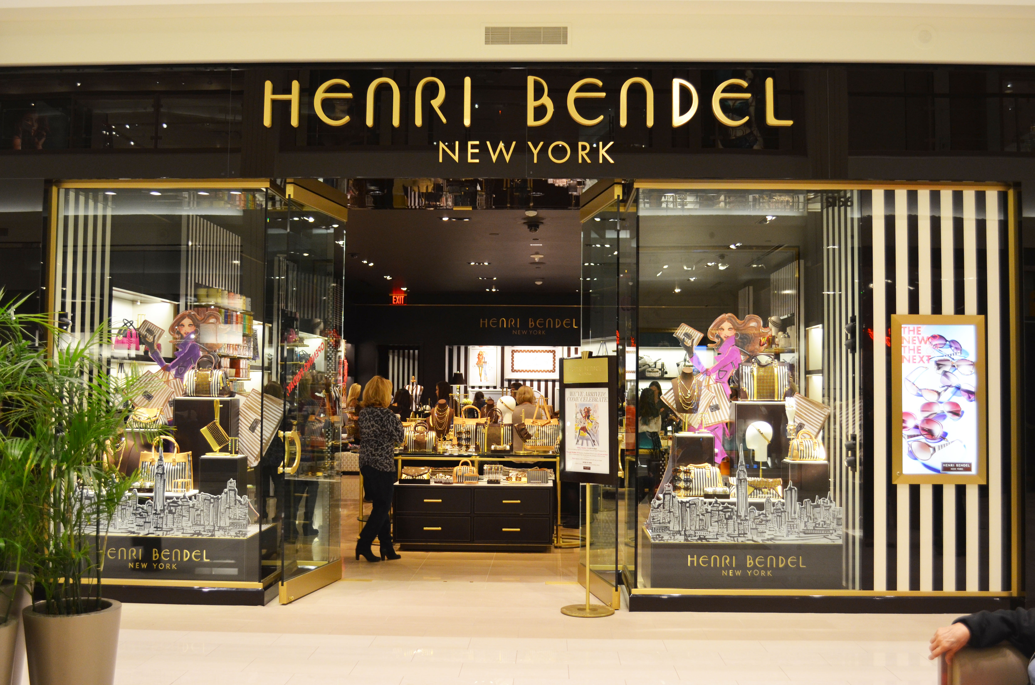
2- Place Utility
Involves having a product where customers can buy it
Retail stores
E-commerce

Slide 13
3- Time Utility
Having a product/service available at a certain time of year or a convenient time of day.
711- open 24/365
Can you think of any examples of a store that is open at a particular time of year/season?

Slide 14
4- Possession Utility
The exchange of a product for money.
Ex. Checks, credit cards, cash, lay away plans.
These options add value to the product.

Slide 15
Think about it
You are looking to buy a new flat screen tv because your current one broke. You have an extra $500 cash, but the one you are interested in buying costs $800. You are dead set on buying this television, it originally sells for $1,200 and is on sale this week only.
What are your payment options?

Slide 16
5- Information Utility
Involves communication with the customer
Ex. Salespeople, displays, packaging and labeling, ownership manuals.

Slide 17
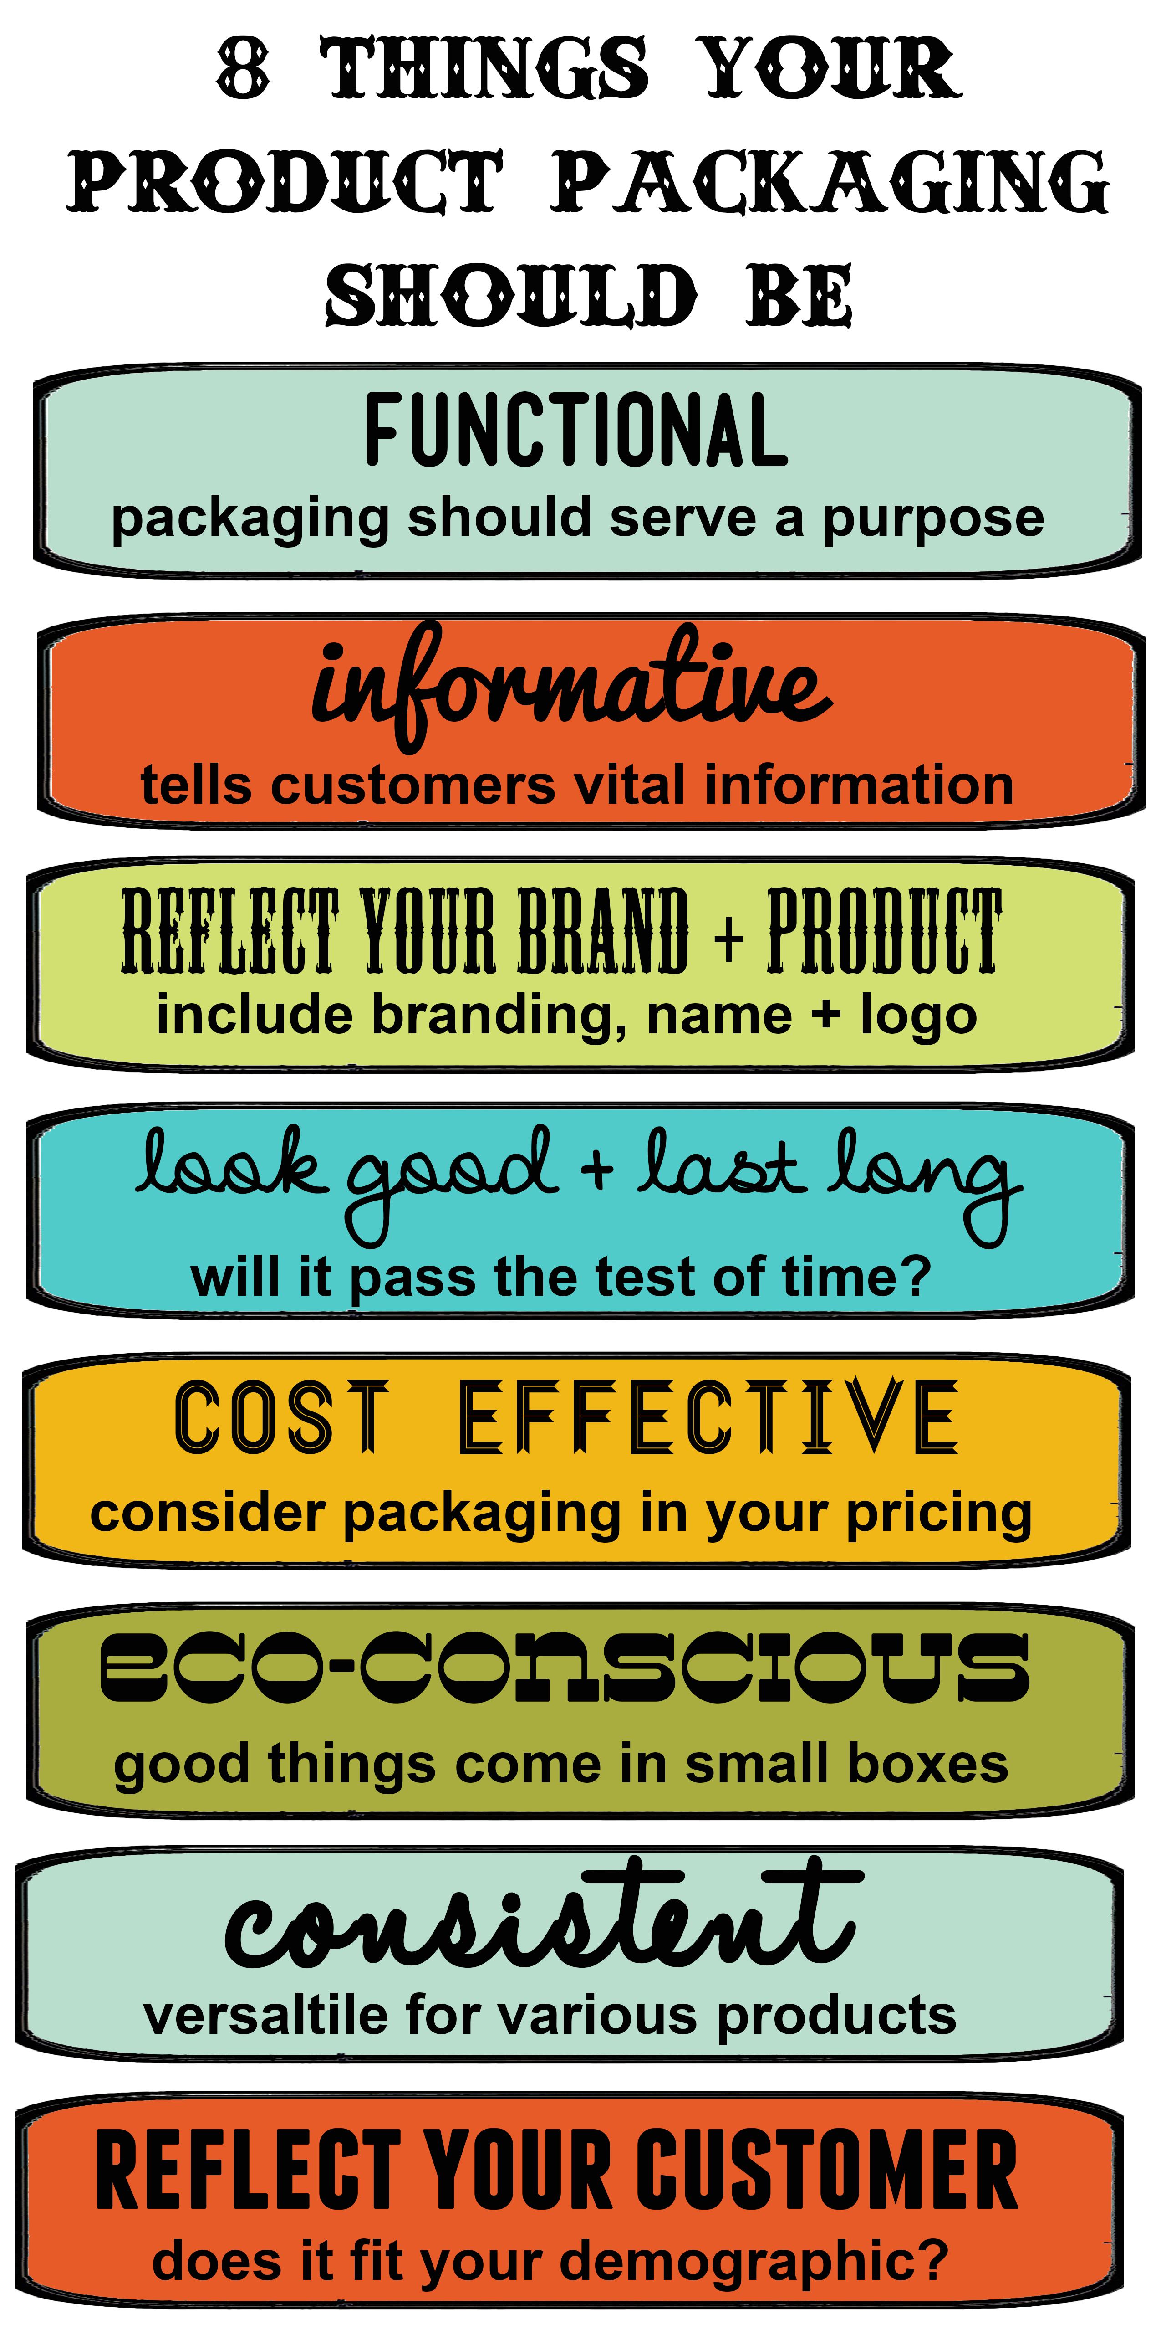
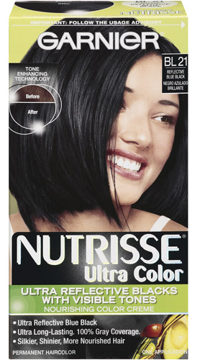
Information Utility (continued)

Slide 18
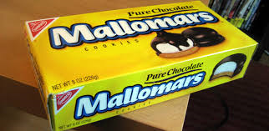
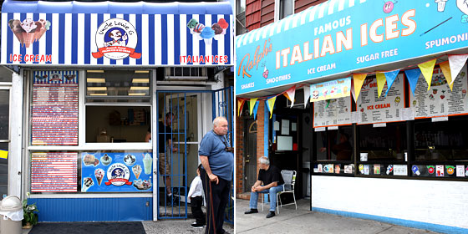
What kind of utilities do these specialize in?
1)
2)

Slide 19
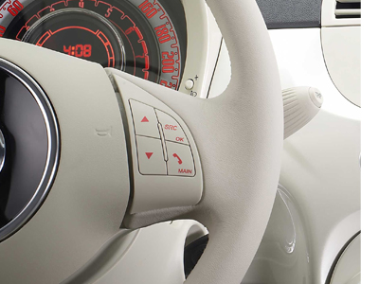
What kind of utilities do these specialize in?
3)
4)

Slide 20
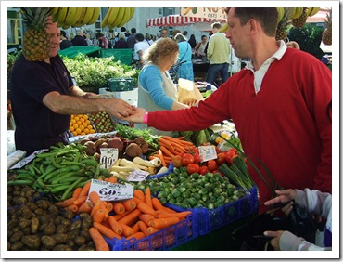
What kind of utilities do these specialize in?
5)

Slide 21
The Five Utilities Project
Design a poster that illustrates the five utilities for one consumer product. You will select a consumer good and gather information to determine how businesses add utility to the good that you have chosen.
Gather enough information to write a substantial amount for each utility.
BRING YOUR OWN MARKERS AND CRAYONS

