Slide 1
Product Life Cycle
Aim: What is a product life cycle?

Slide 2
The Main Idea
After products are introduced in the marketplace, they go through different stages of growth and decline. It is important to understand the different marketing strategies used to sustain product sales over time.

Slide 3
The next apple?
http://www.bbc.com/news/business-32601731

Slide 4
Product Life Cycle
Represents the stages that a product goes through during its life.
There are four stages of the life cycle:
Introduction,
Growth,
Maturity
Decline.
As each stage is reached marketers must adjust their product mix and their marketing strategies to ensure continued sales.

Slide 5
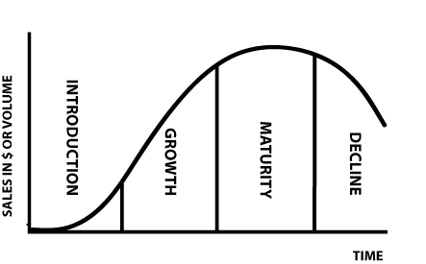
Sales in $ Over time- Product Life Cycle

Slide 6
1) Introduction Stage
Company focuses its efforts on promotion and production
The major goal is to draw the customer’s attention to the new product
Works to increase product awareness
The costs of introducing a product are high, therefore this is usually the least profitable stage of the life cycle

Slide 7
Growth Stage
Product enjoys success as shown by increasing sales and profits
More competitors enter the marketplace
Much of the target market knows and buys the product
Advertising may now focus of consumer satisfaction rather than on benefits
Competition is aware of product and will likely offer new products in order to compete
In order to keep sales growing, the company may have to order new models or modify existing product

Slide 8
Maturity Stage
Sales start to level off
Product has more competition
Most of the target market owns the product
Advertising expenses climb in order to fight off competition
https://www.youtube.com/watch?v=C5z0Ia5jDt4 –
Apple and PC
https://www.youtube.com/watch?v=lYZVAR5kcrw
Surface and iPad
https://www.youtube.com/watch?v=aqBWnjloU0I
Mc Donalds and Taco Bell
https://www.youtube.com/watch?v=XiNPG9womnc
Verizon and competitors

Slide 9
Decline Stage
Sales fall and profits can become smaller than costs
Management has to decide how much longer it will support the product
Drop the product

Slide 10
Strategies During the Decline Stage
Sell or license the product
Recommit to the product line
Discount the product
Regionalize the product – based on strong customer loyalty
Modernize or alter the product offering ex. Tide laundry detergent
Companies spend large amounts of money to develop and promote products
As a result they are reluctant to delete products without trying some of the strategies mentioned
When products must be dropped, a company needs to plan a move carefully to avoid disappointing customers and damaging its overall image.

Slide 11
Case Study- The iPod
http://www.bbc.com/news/technology-25927366

